Slide 1
Linear Programming
Statistics 186

Slide 2
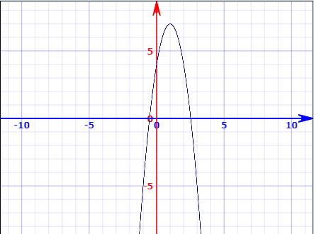

Introduction
Interested in optimize functions
Functions in one variable
$$y=−3x^{2}+6x+4$$
How to get maximum?
Take derivative
Set equal to zero
Solve for variable of interest

Slide 3
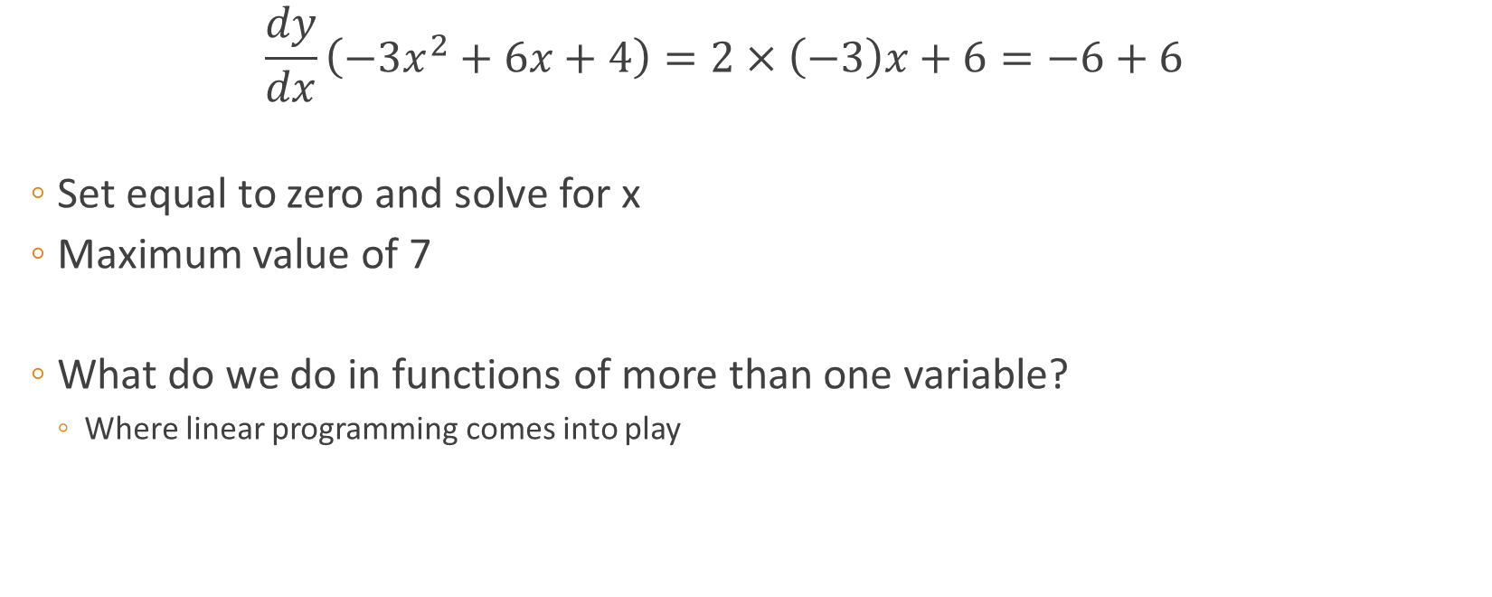
$$\frac{dy}{dx}\left(−3x^{2}+6x+4\right)=2×\left(−3\right)x+6=−6+6$$
Set equal to zero and solve for x
Maximum value of 7
What do we do in functions of more than one variable?
Where linear programming comes into play

Slide 4
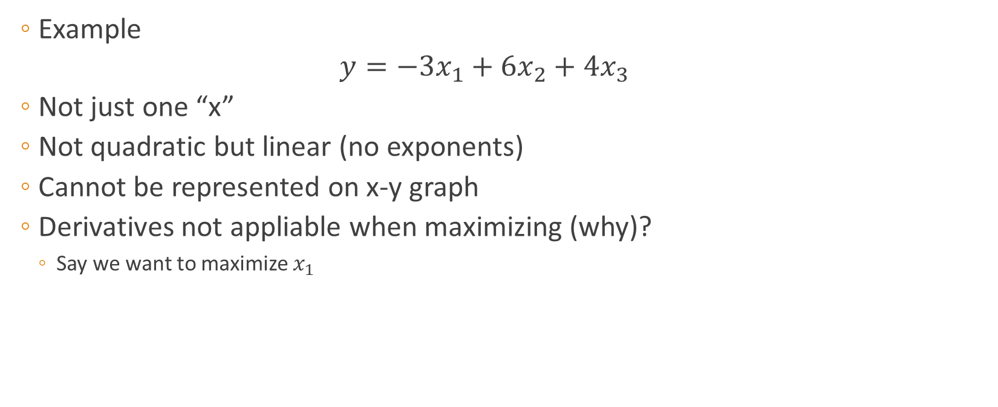
Linear functions in more than one variable
Example
$$y=−3x_{1}+6x_{2}+4x_{3}$$
Not just one “x”
Not quadratic but linear (no exponents)
Cannot be represented on x-y graph
Derivatives not appliable when maximizing (why)?
Say we want to maximize $x_{1}$

Slide 5

$$\frac{dy}{dx_{1}}\left(−3x_{1}+6x_{2}+4x_{3}\right)=−3+0+0=−3$$
Now what?
Linear programming!

Slide 6
Methods available
Geographical method
Involves obtaining graphical representation when certain constraints are appliable
In this course only be restricted to two products
Call them A and B
No. of A produced on x-axis and No. of B produced on y-axis
Extreme point method
Will briefly touch on later
Simplex method
Not covered in this course

Slide 7
Optimisation (refer back to this)
Steps
State objective function
Determine constraints
Represent constraints graphically
Represent objective function graphically
Calculate optimal solution

Slide 8
Example 1
2 departments (machining and finishing) with capacity of 1200 each day
Machining department: 10 of A or 5 of B per hour
Finishing department: 6 of A or 10 of B per hour
Limit of product B (3kg per unit) to 270kg per day
Contribution: R2 for A and R2.5 for B per product
Notes:
Make note of constraints and state that we intend to maximise daily contribution => that is our objective function

Slide 9

Step 1 – State objective function
$$P=2A+2.5B$$

Slide 10
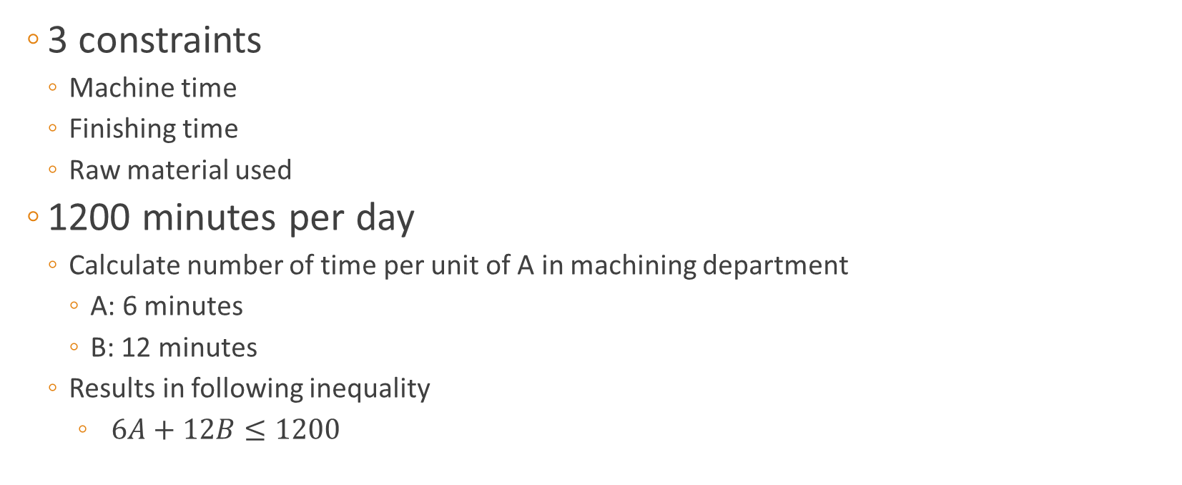
Step 2 – Determine Constraints
3 constraints
Machine time
Finishing time
Raw material used
1200 minutes per day
Calculate number of time per unit of A in machining department
A: 6 minutes
B: 12 minutes
Results in following inequality
$6A+12B≤1200$

Slide 11
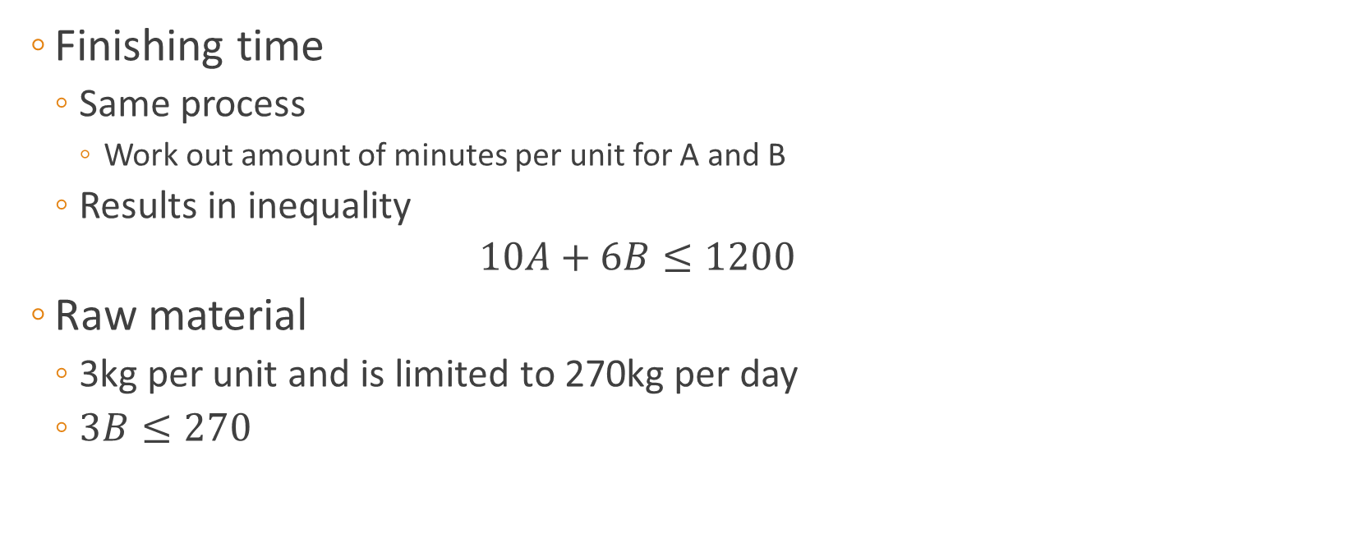
Step 2 – Determining Constraints
Finishing time
Same process
Work out amount of minutes per unit for A and B
Results in inequality
$$10A+6B≤1200$$
Raw material
3kg per unit and is limited to 270kg per day
$3B≤270$

Slide 12

Step 2 – Determining Constraints
“Hidden Constraint”
Cannot have negative items produced
$$A≥0$$
$$B≥0$$

Slide 13
Step 3 – Represent Constraints Graphically
In cases where A and B are in the inequality
Determine intercepts
Draw line
NB: Take note of sign of inequality to see if to shade above or below the line

Slide 14
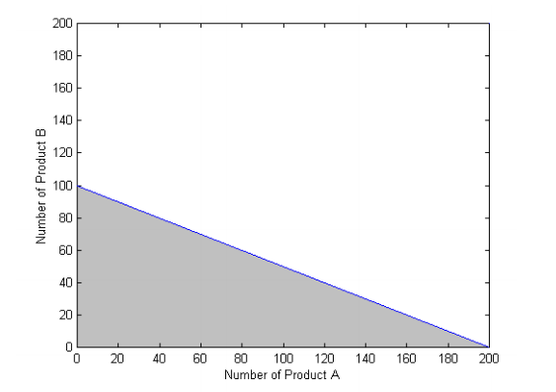
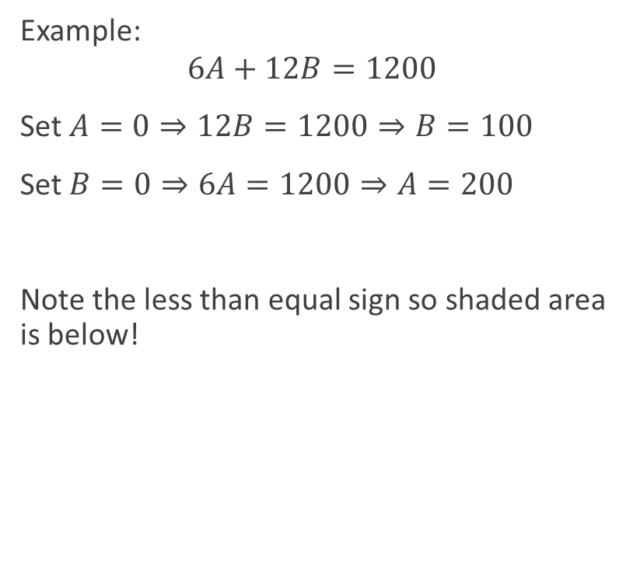
Step 3 – Represent Constraints Graphically
Example:
$$6A+12B=1200$$
Set $A=0⇒12B=1200⇒B=100$
Set $B=0⇒6A=1200⇒A=200$
Note the less than equal sign so shaded area is below!

Slide 15
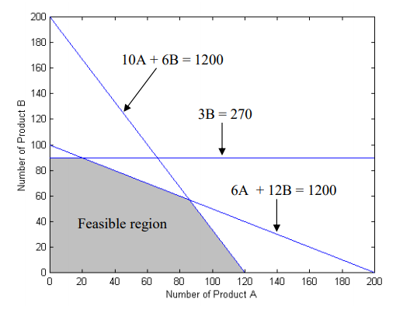
Step 3 – Represent Constraints Graphically
Considering other constraints results in following graph

Slide 16
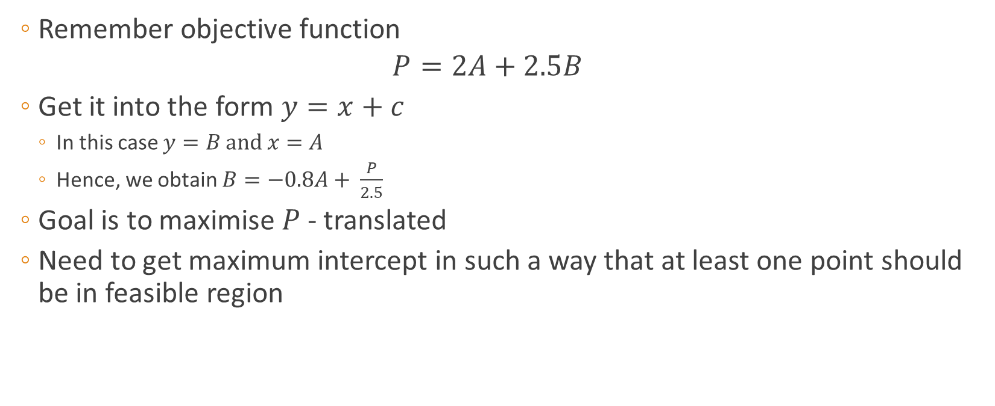
Step 4 – Represent the Objective Function Graphically
Remember objective function
$$P=2A+2.5B$$
Get it into the form $y=x+c$
In this case $y=B \text{and} x=A$
Hence, we obtain $B=−0.8A+ \frac{P}{2.5}$
Goal is to maximise $P$ - translated
Need to get maximum intercept in such a way that at least one point should be in feasible region

Slide 17

Step 4 – Represent the Objective Function Graphically
Start by choosing random value for $P$
Hint: Choose one in such a way that the $y$-intercept is in the middle of the axis

Slide 18
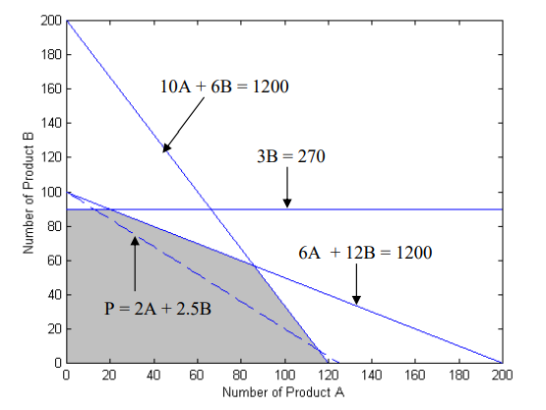

Step 4 – Represent the Objective Function Graphically
Start by choosing random value for $P$
Hint: Choose one in such a way that the $y$-intercept is in the middle of the axis
Graph $B=−0.8A+100$

Slide 19
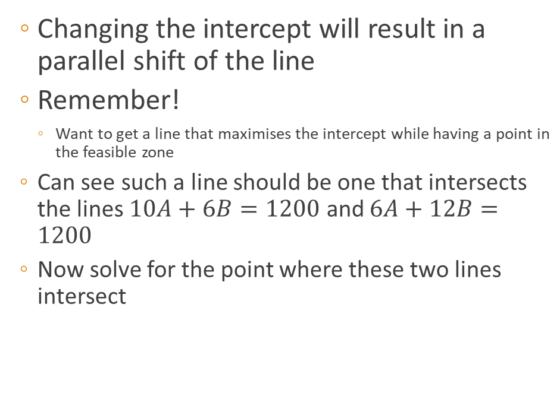
Step 4 – Represent the Objective Function Graphically
Changing the intercept will result in a parallel shift of the line
Remember!
Want to get a line that maximises the intercept while having a point in the feasible zone
Can see such a line should be one that intersects the lines $10A+6B=1200$ and $6A+12B=1200$
Now solve for the point where these two lines intersect

Slide 20
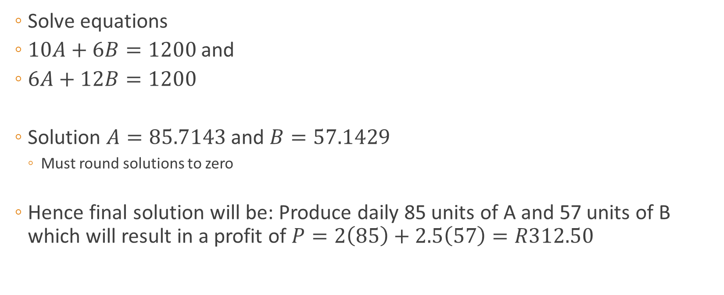
Step 5: Calculate optimal solution and resulting optimal profit
Solve equations
$10A+6B=1200$ and
$6A+12B=1200$
Solution $A=85.7143$ and $B=57.1429$
Must round solutions to zero
Hence final solution will be: Produce daily 85 units of A and 57 units of B which will result in a profit of $P=2\left(85\right)+2.5\left(57\right)=R312.50$

Slide 21
Summary
Linear programming involves optimizing objecting functions
Remember the steps
Next week will tackle another example (don’t stress!) ☺

